Slide 1
Crowdfunding Projects Performance & Analytics

Slide 2
Tools Used :- Excel | Tableau| Power B | SQL
Prepared By:-
Sakshi Pimple
Sarvadnya Thube
Vishwas Dinesh Tuvar
Babita Yadav
soora Maheswari
Tejas Arun Shinde
Vishwas Dinesh Tuvar
Raxit Pansuriya

Slide 3
Introduction
Crowdfunding platforms have thousands of projects, but not all of them reach their funding goals. This project looks at crowdfunding data to:
Find patterns that lead to success
Evaluate how well projects are funded
Analyze trends by category and country
Measure the overall success rate
The goal is to use SQL to get insights from the data and then show these insights using dashboards in Excel, Tableau, and Power BI.

Slide 4
📊 KPIs & Insights Slide Key Performance Indicators (KPIs)
Total Projects: 365,892
Total Backers: 45M
Total USD Pledged: $3.85B
Total Categories: 169
Total Locations: 22K
Overall Success Rate: 38%🔎

Slide 5
🔎 Key Insights
🔹 Failure rate (~52%) is higher than success rate.
🔹 US contributes the highest number of projects.
🔹 Product Design & Games dominate categories.
🔹 Average pledged amount ≈ $10,538.
🔹 Top-funded projects exceed multi-million USD funding.
🔹 Funding activity peaked around 2014–2016.

Slide 6
Excel Dashboard Slide 📊 Excel Dashboard Highlights
Year-wise project growth trend Category-wise project
Distribution Projects by outcome (Successful, Failed, Cancelled)
Top 10 locations by project
countAvg Goal vs Avg Pledged
comparison Overall Success Rate visualization

Slide 7
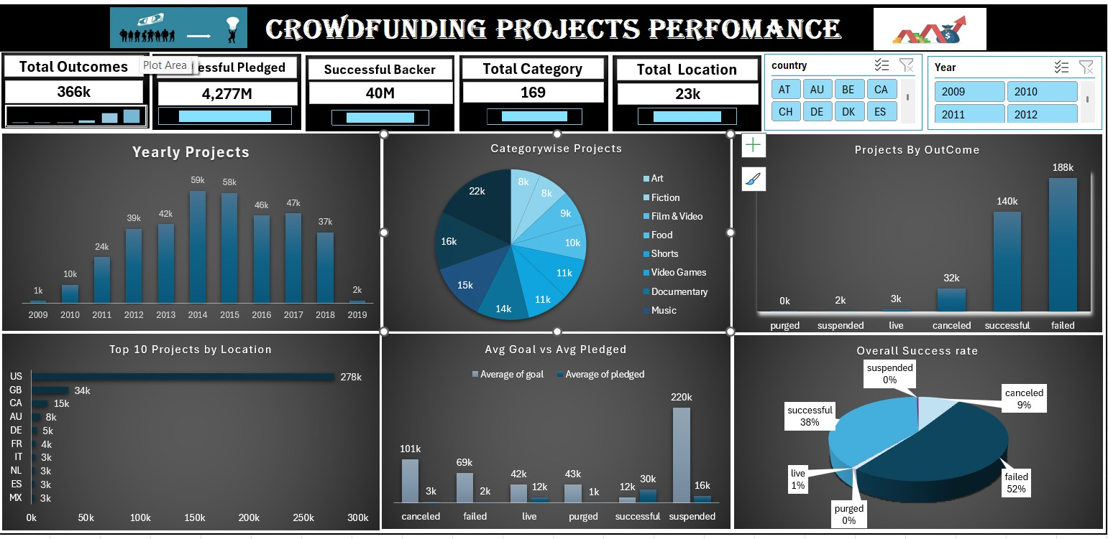
Excel Dashboard Image

Slide 8
Tableau Dashboard Slide 📈 Tableau Dashboard Highlights
Project status distribution
Top 10 categories by amount raised
Goals distribution by country
Year-wise funding trend (%)
Top projects by backers count
Interactive filters (Year, Country, State)

Slide 9
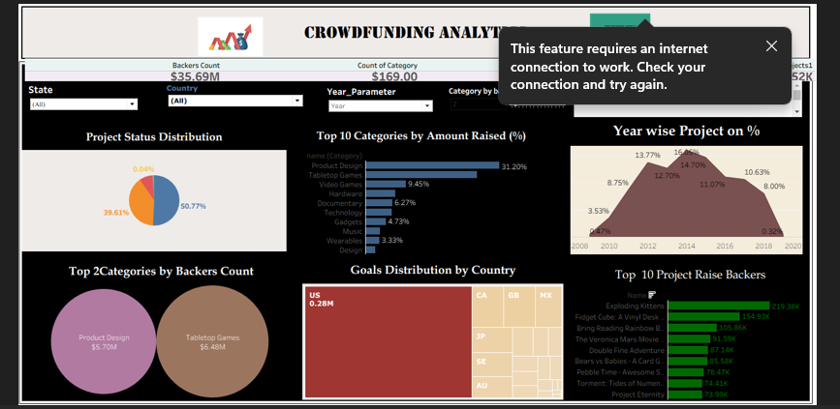
Tableau Dashboard Image
📌 Insight: Interactive analysis shows strong US dominance and category concentration in Product Design.

Slide 10
Power BI Dashboard Slide 📊 Power BI Dashboard Highlights
KPI Cards (Backers, Pledged, Projects, Categories, Locations)
Monthly funding trend line
Category funding % breakdown
Country-wise project count
Funding gap gauge visualization
Category vs Backers scatter analysis

Slide 11
Power BI Dashboard Image
📌 Insight: Funding is concentrated in specific categories with high backer engagement.

Slide 12
SQL Queries Output Slide SQL Analysis Performed
✔ COUNT() → Total records validation
✔ SUM() & AVG() → Financial metrics
✔ GROUP BY → State & Country analysis
✔ JOIN → Category-wise performance
✔ SUBQUERY → Above-average funded projects
✔ CASE WHEN → Success rate calculation
✔ WINDOW FUNCTION (RANK()) → Top funded projects ranking
✔ VIEW → Simplified reporting structure
✔ STORED PROCEDURE → Dynamic high-funded project extraction

Slide 13
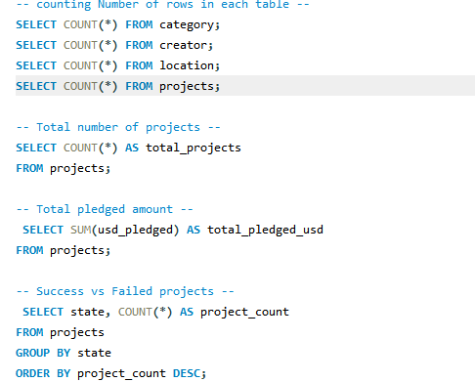
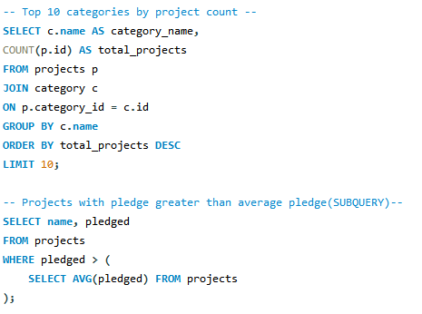
SQL Queries Output Image
📌 Demonstrated advanced SQL concepts with real dataset.

Slide 14
Project Summary Slide 🎯 Project Summary
Performed end-to-end data analysis on crowdfunding dataset.
Applied advanced SQL techniques for data extraction.
Built dashboards in Excel, Tableau, and Power BI.
Identified key funding trends and success patterns.
Demonstrated strong data analysis and BI tool skills.

Slide 15
💡 Business Recommendations
Focus marketing on high-performing categories.
Improve screening criteria to reduce failure rate.
Target regions with lower participation for expansion.
Promote successful project case studies to increase trust.

